Slide 1
Meeting notes 11.21

Slide 2
Things done
Extended training DB:
  Instead of only training on target distributions, randomly create unknown regions on workspace with the different target distribution
  target distribution + unknown region represented as GP
  Create a teacher trajectory on GP
  Training finished this morning, no testing done with new model
More evaluation
Comparison to Flow Matching Ergodic Coverage

Slide 3
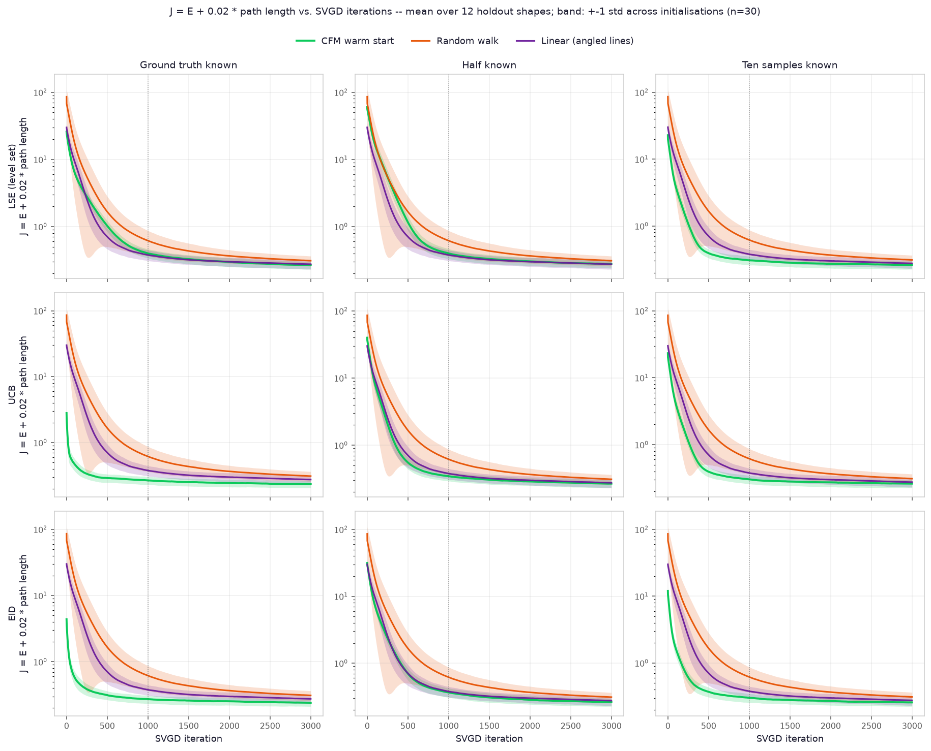
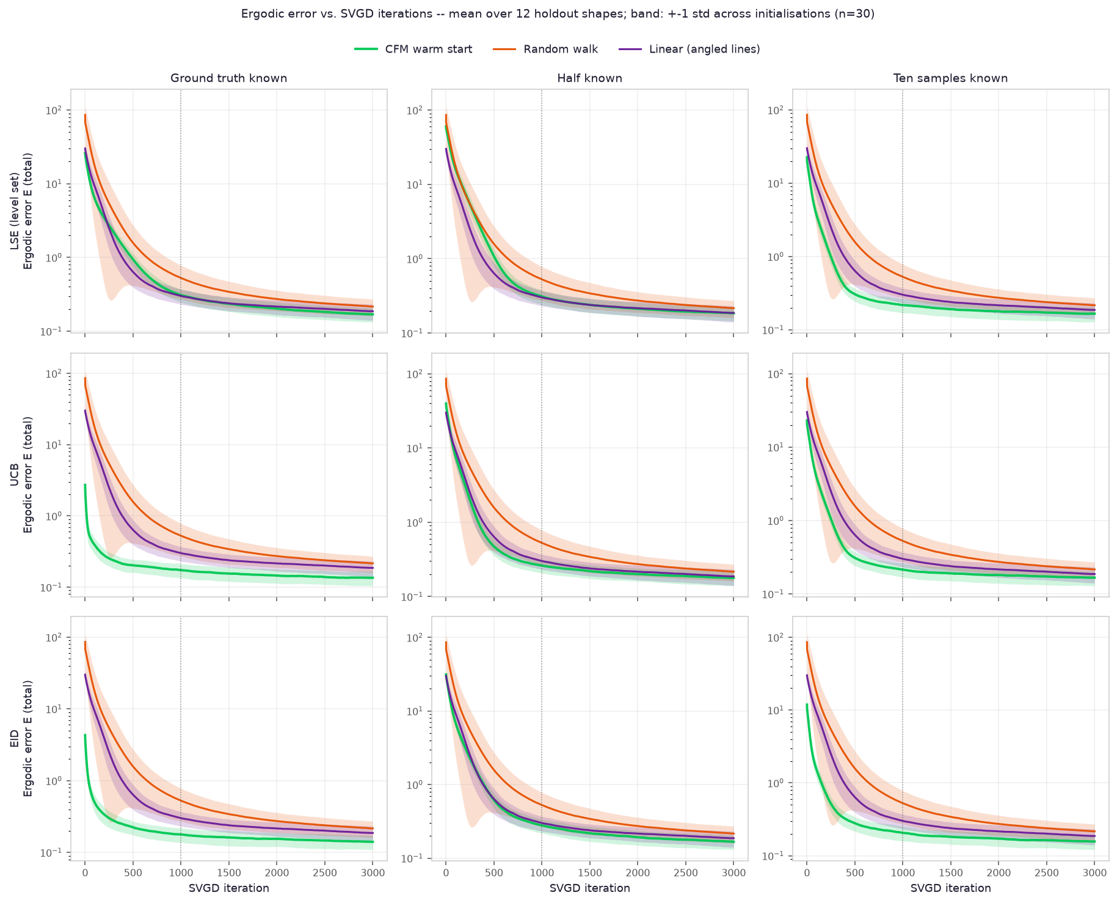
Evaluation svdg iteration untill ergodicity / J convergence

Slide 4
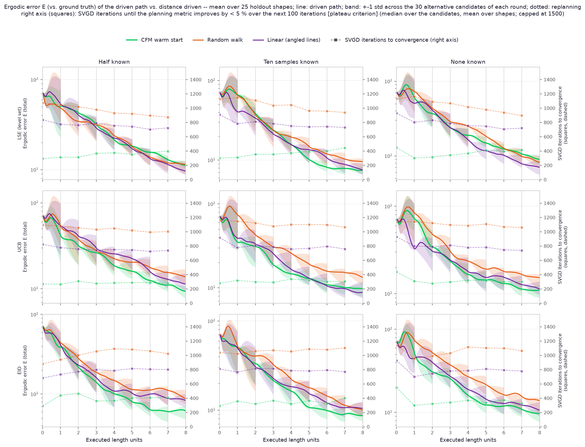
Evaluation
Replanning system:
Execute length unit, update, replan
Developement of ergodicity

Slide 5
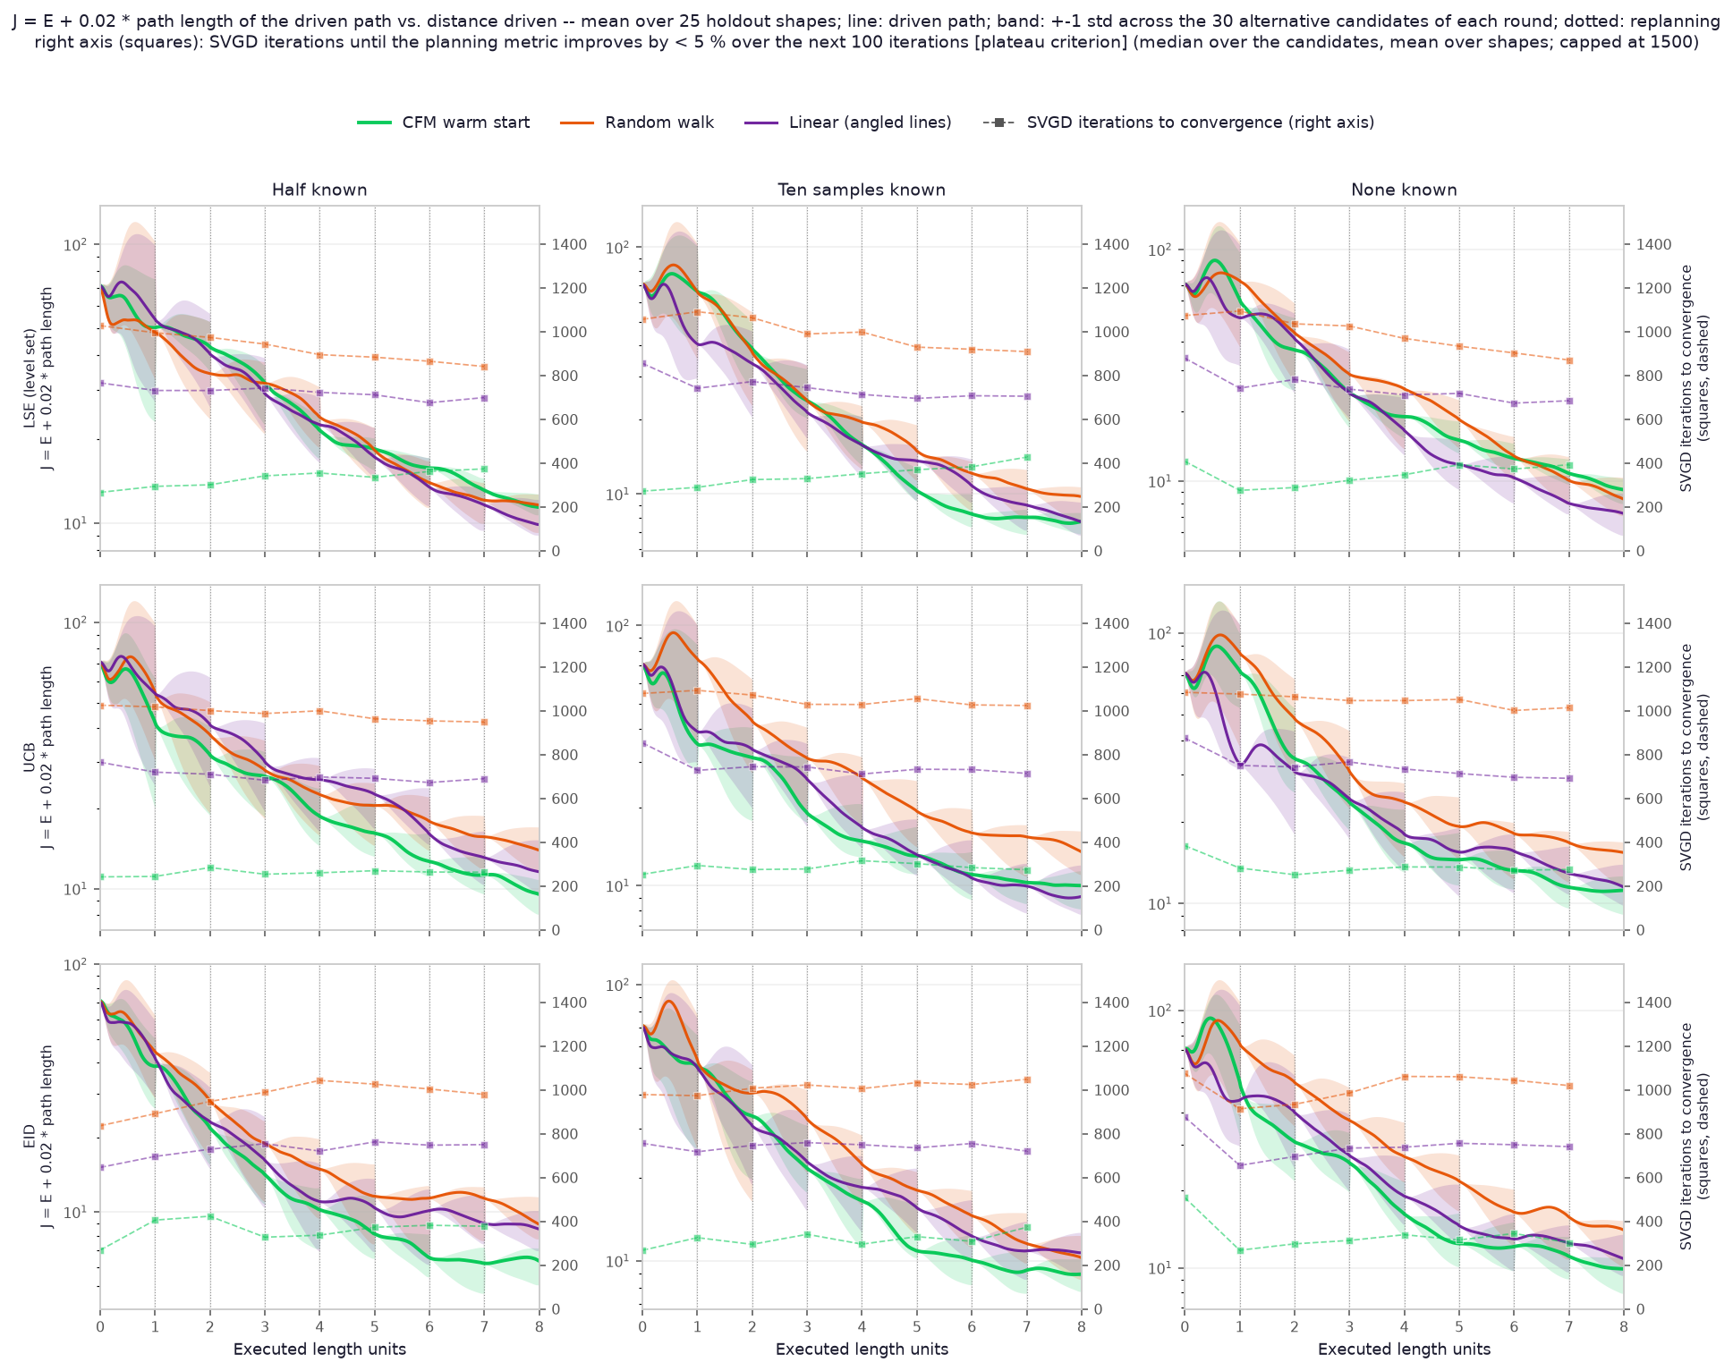
Evaluation

Slide 6
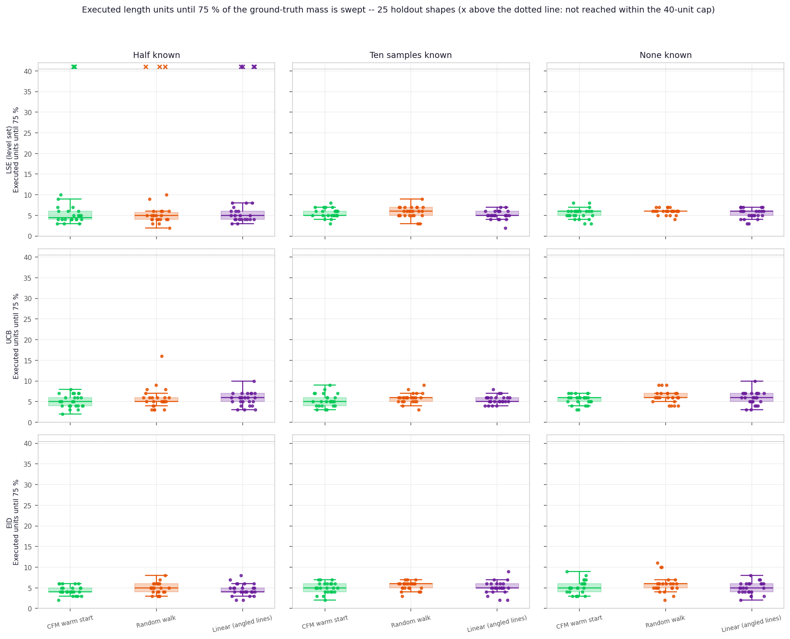
Target shape recovery

Slide 7
Recreate evaluations from sun et al
Problems to recreate/understand fig 6
Very short explaination, no code comparison
There is no way it could know about the target distribution in the lower center

Slide 8
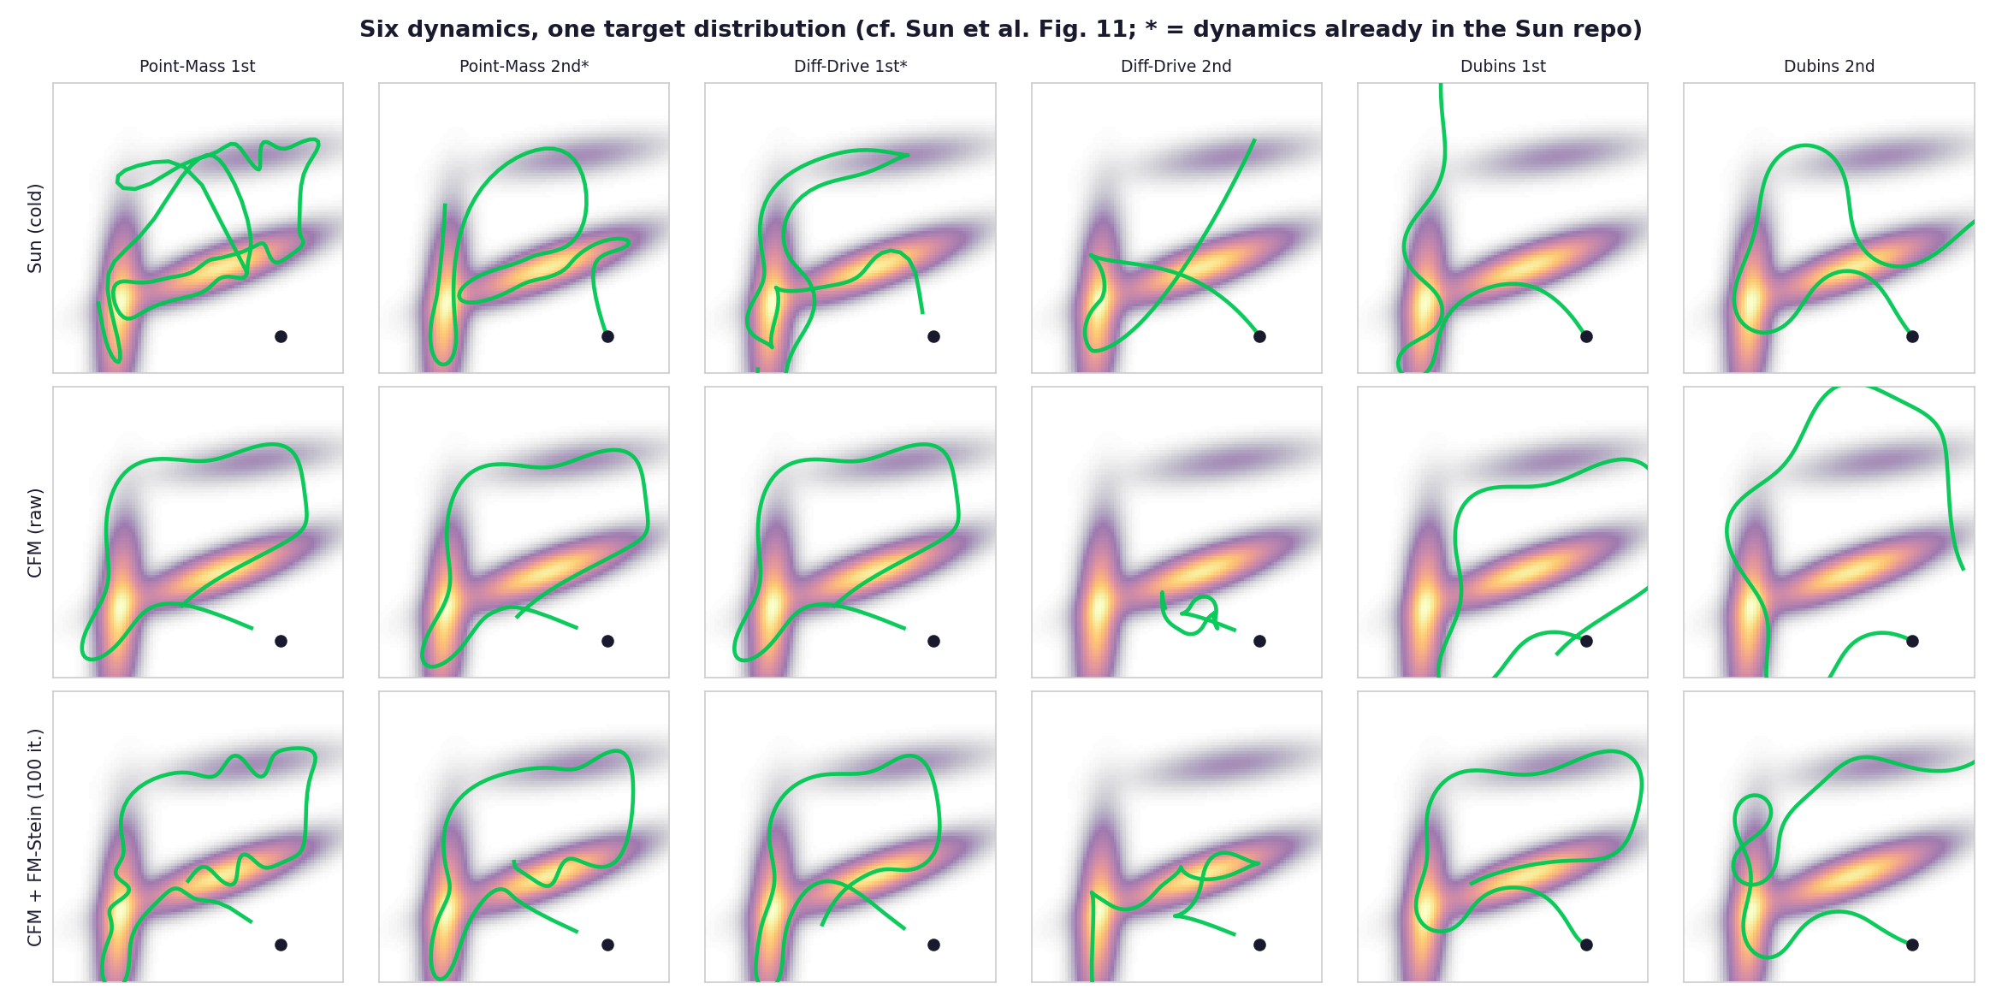
Comparison to fig 11

Slide 9
Researchquestions
Does the CFM intialization allow for a faster ergodicity convergencs in general? – Yes
Does the CFM intialization allow for a faster ergodic coverage of unknown regions? - Yes
Does the CFM intialization allow for a faster recovery of unknown regions? – Not really – Yet?

Slide 10
Plans for next week
Test new model
Implement MuJoCo simulation for a realistic lab setting
Open Questions: How to deal with 3D obstacles for the robot arm, not only the endeffector?

